Slide 1
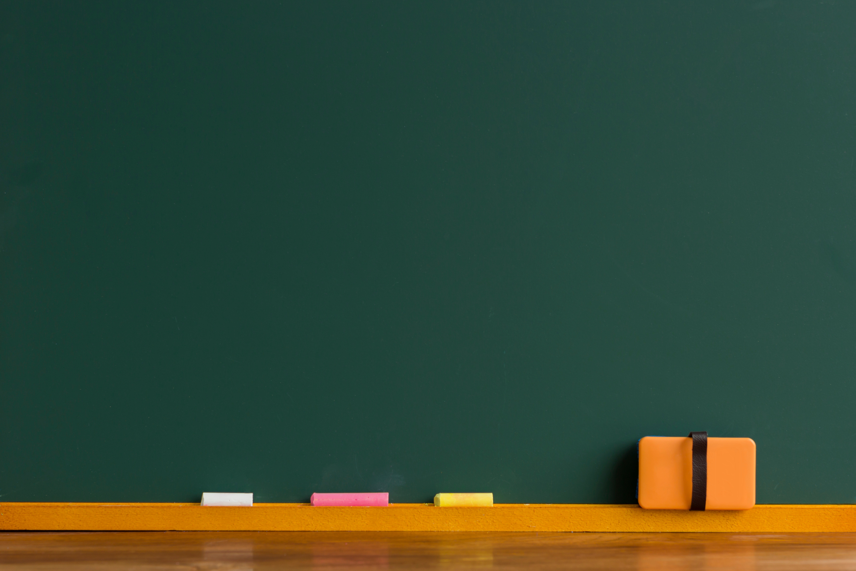

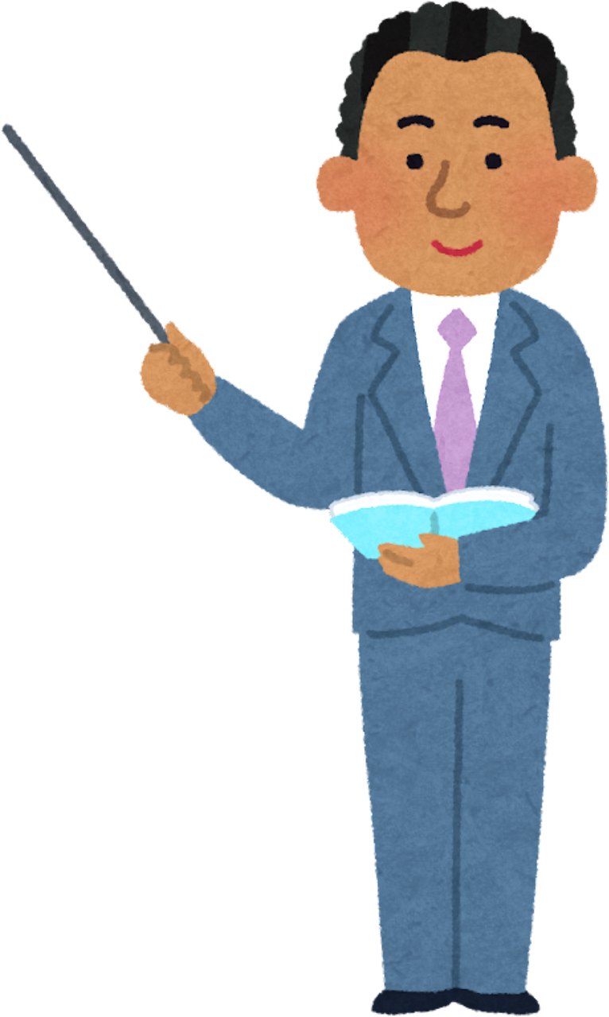

Python Programming Summer Camp
Class # 1
Printing Fun – Say Hello to Python
By Asim Munawar

Slide 2
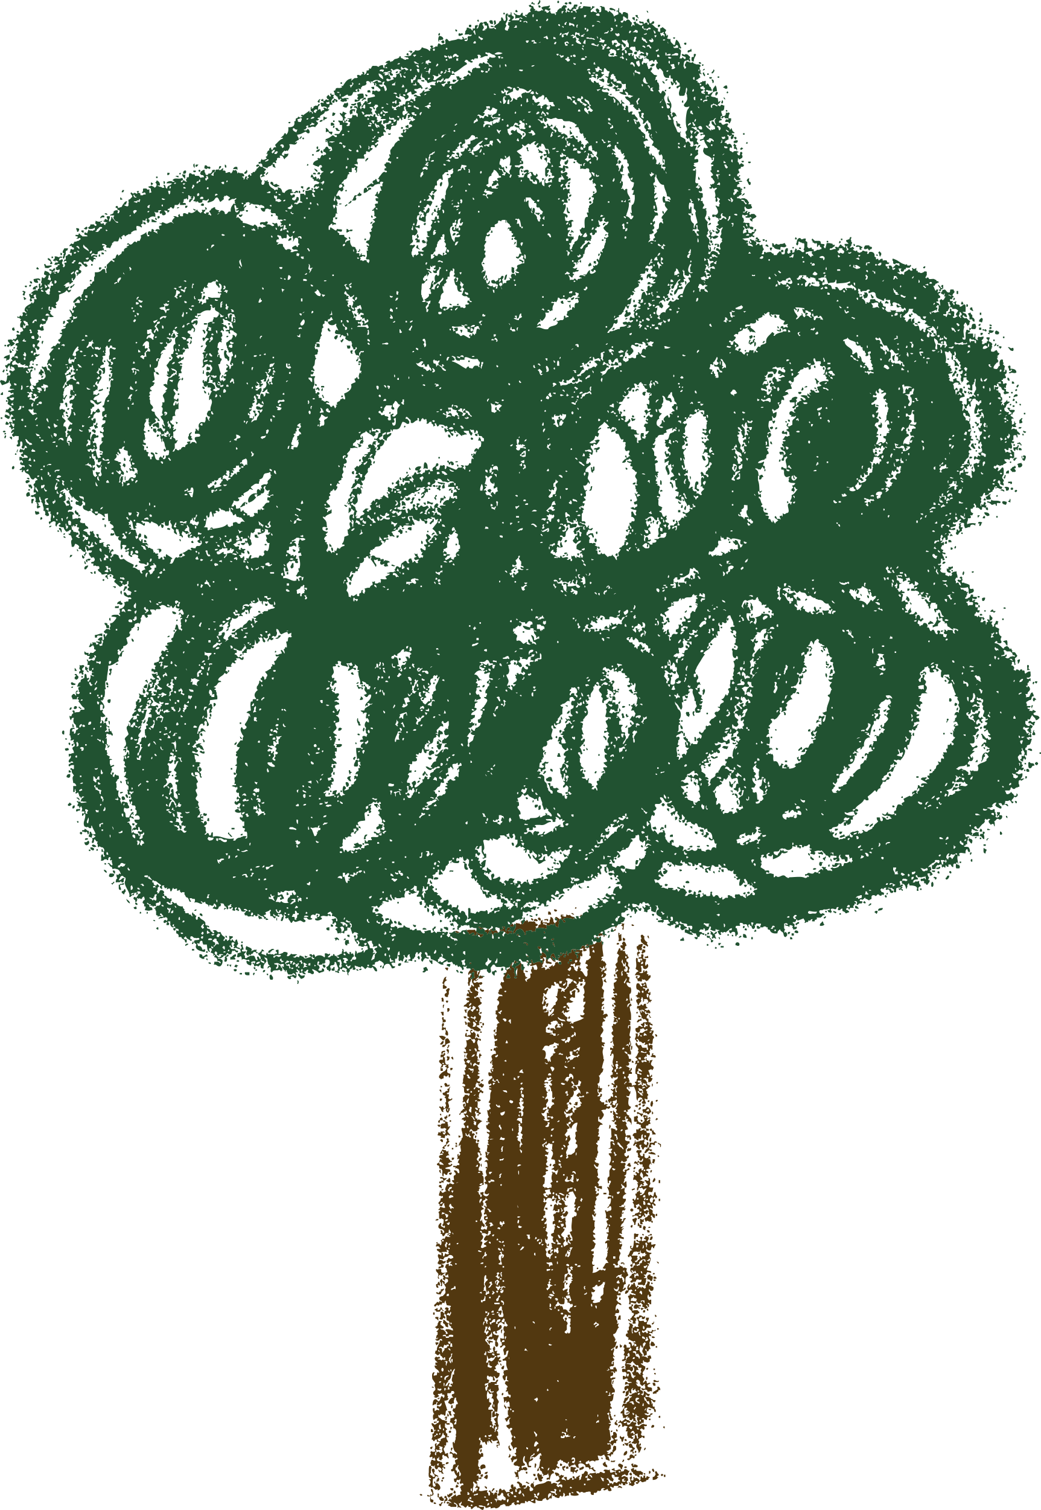
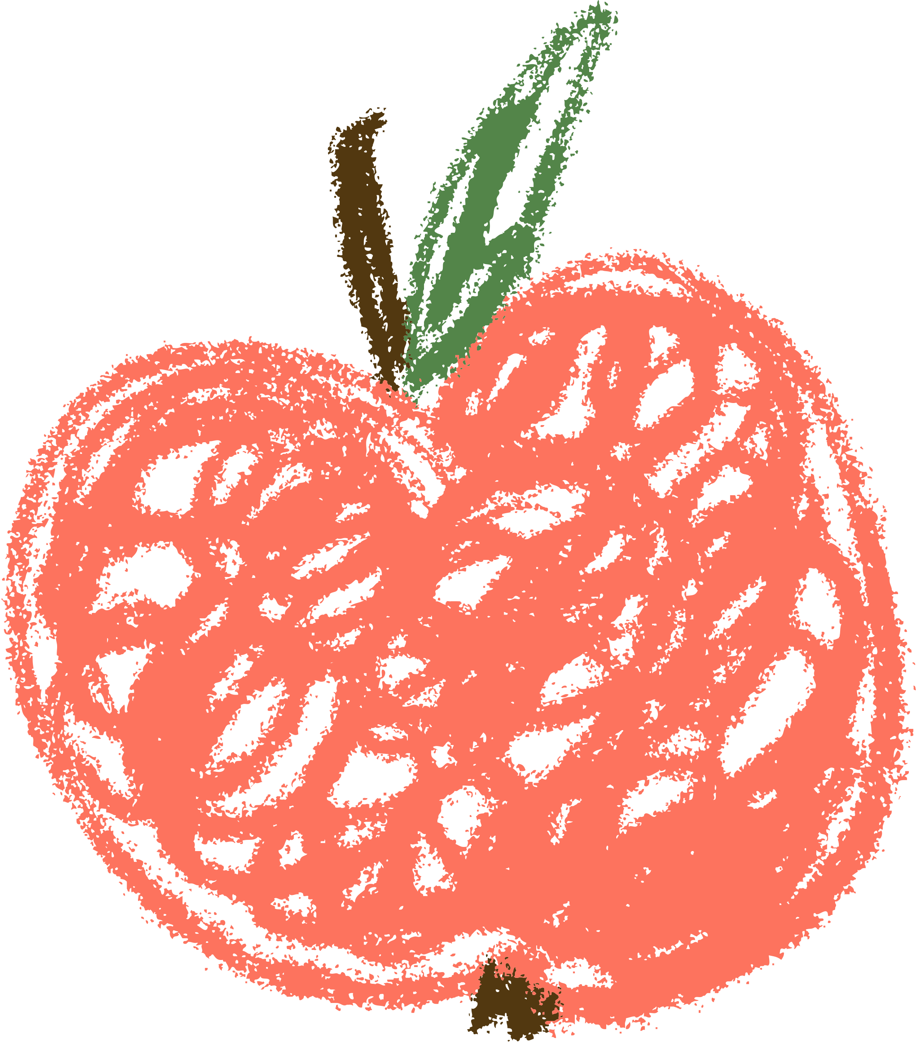
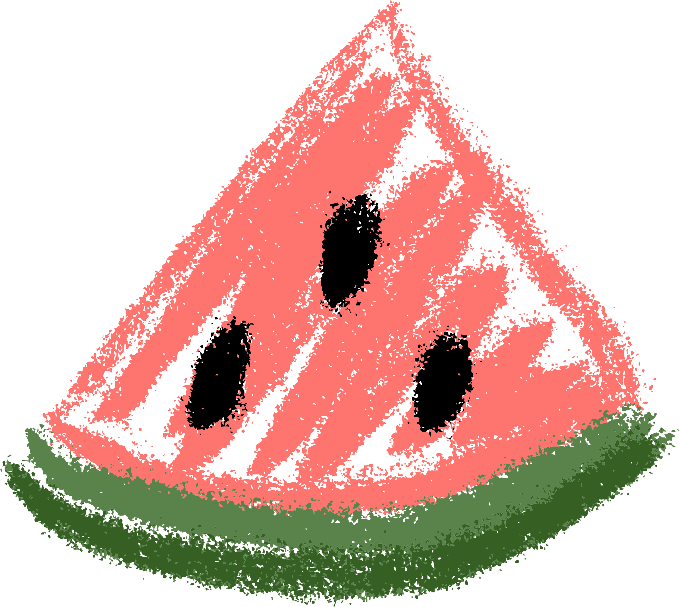
Promise
I will attend all classes
I will do my homework by myself
I will not use AI for anything
Getting help from parents is ok
I will have fun
I will become the worlds best programmer

Slide 3
What skill these people have in common?
Mark Zuckerburg
Elon Musk
Bill Gates
They are all amazing progammers

Slide 4


Course Plan
Lesson 1: Printing Fun – Say Hello to Python
Lesson 2: Variables – Remembering Things in Code
Lesson 3: If/Else – Making Decisions
Lesson 4: Loops – Doing Things Again and Again
Lesson 5: Build a Mini Game – Guessing or Quiz
Lesson 6: Lists – Collecting Many Things
Lesson 7: Functions – Teach the Computer a New Trick
Lesson 8: Files – Saving and Reading Data
Lesson 9: Simple App with Gradio – Make Your Own Tool
Lesson 10: Final Project – Build and Present Your App

Slide 5
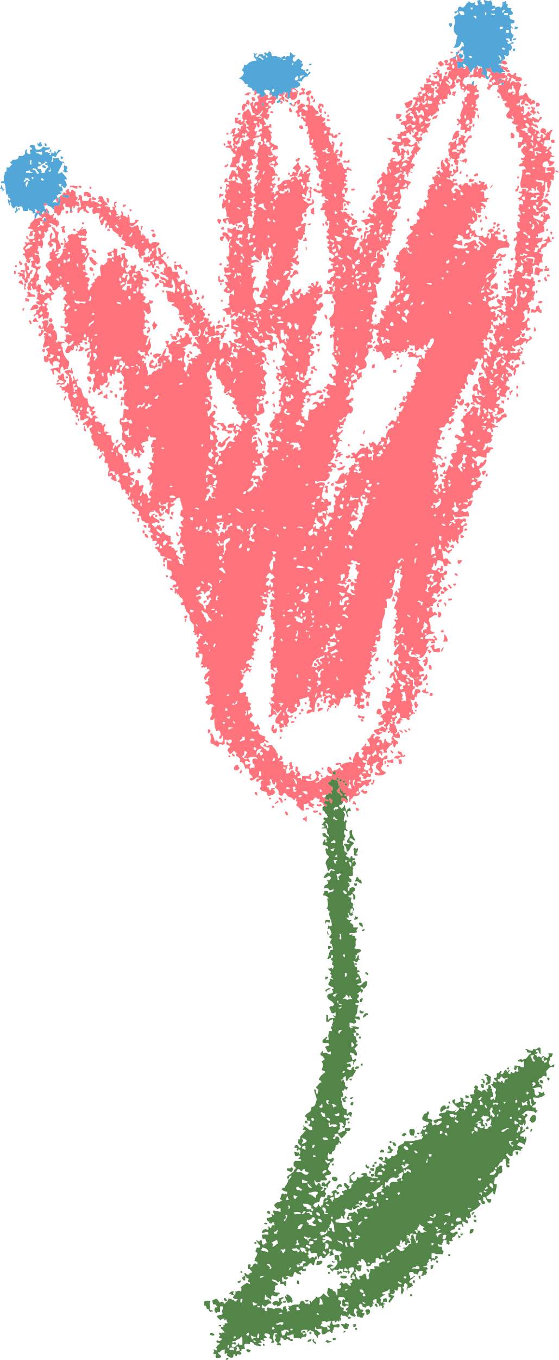
Why Are Computers Dumb?
Computers don’t know anything on their own
They only follow the exact instructions
They can’t 'guess' or 'understand' like humans
That’s why we need to be very clear!
No thinking | No guessing | No common sense

Slide 6
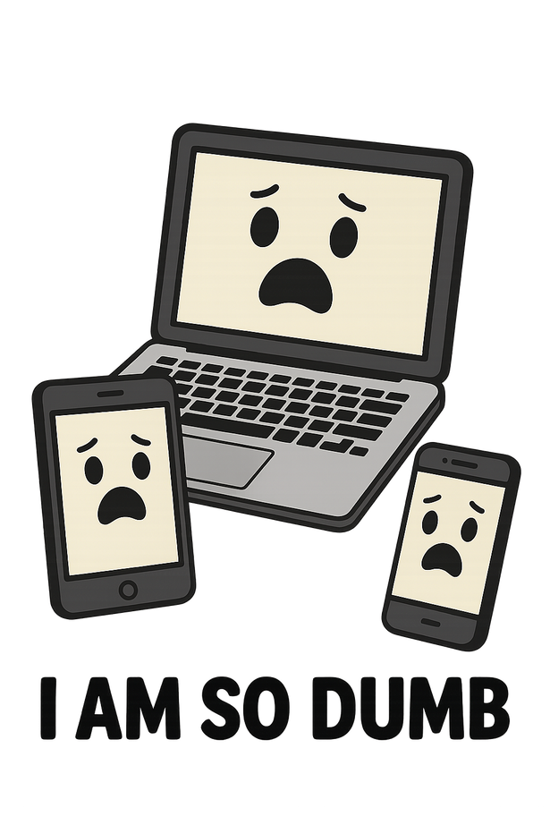
Why Are Computers Dumb?
If you tell a computer:
“Make me a sandwich.”
It won’t know what bread is
It won’t know where the bread is
It won’t know where the kitchen is
Unless you explain it step-by-step!
I’m such a dumbo

Slide 7
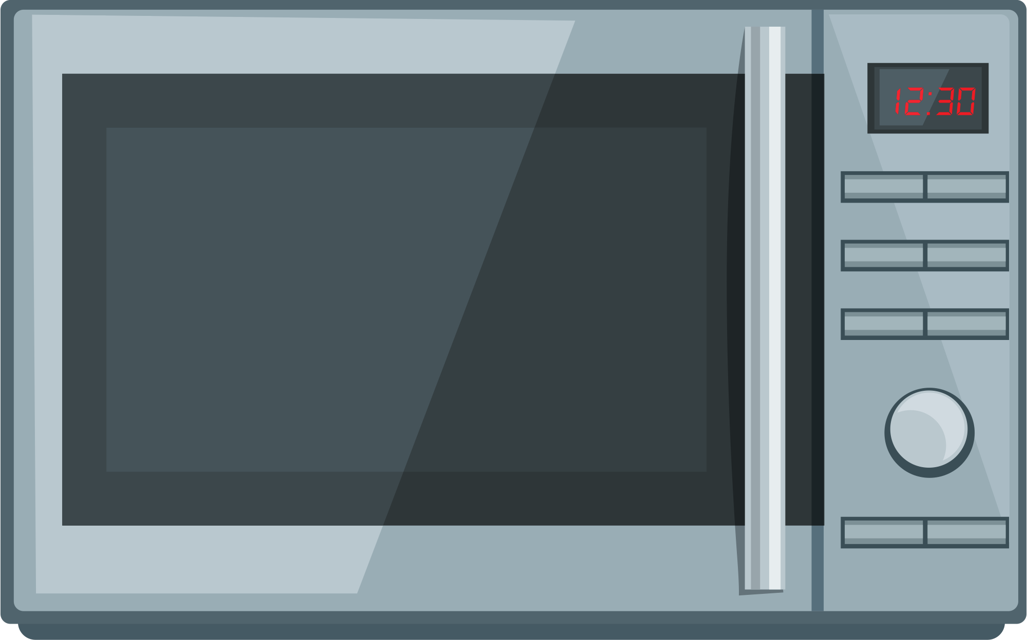
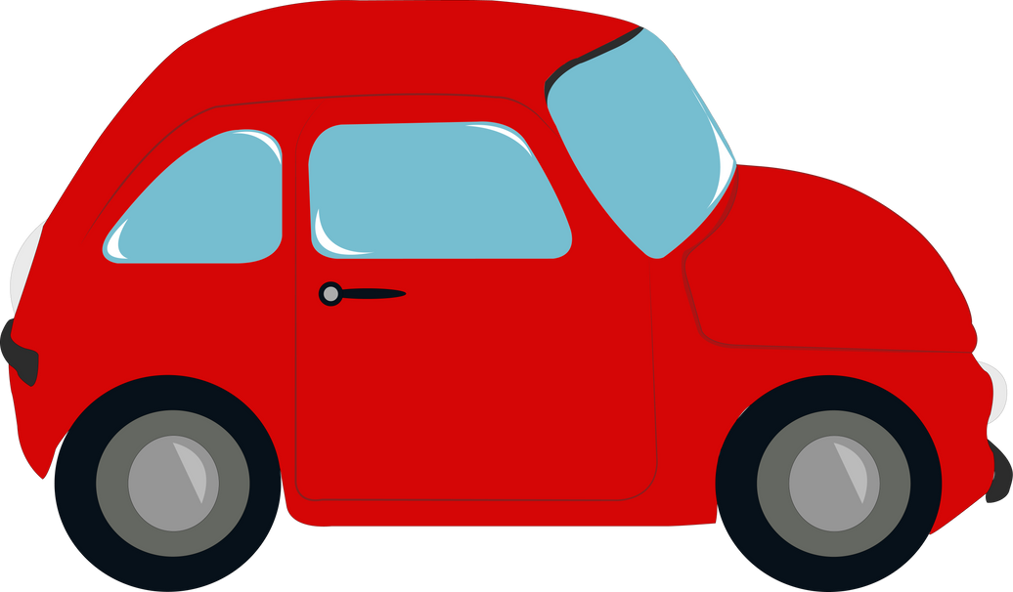
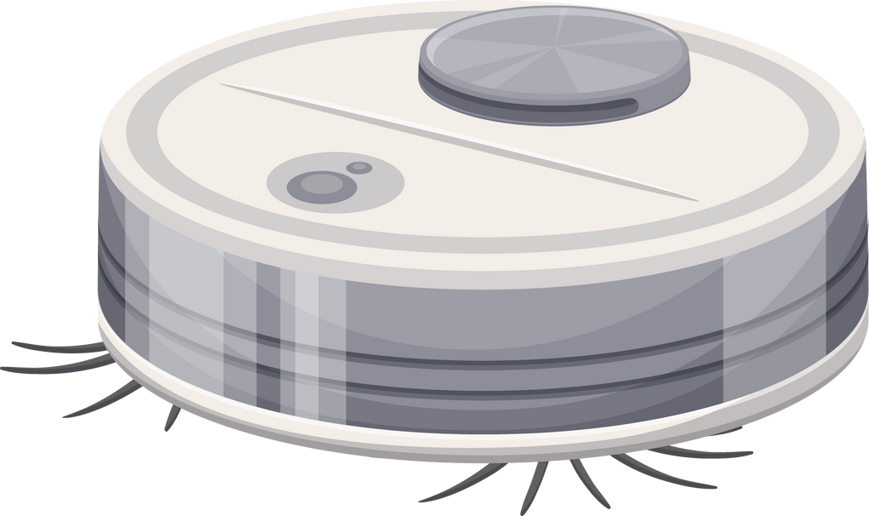
We are surrouned by Computers
.... What Else?

Slide 8


Task: Tell a Robot To Get Water From Refrigerator
Go to the Kitchen
Open Refrigerator
Get water from 2nd shelf on the door
Close fridge
Get back to the living room
Get close to me, without hitting me
Turn left
Move 10 steps forward
Turn right
Move 8 steps forward
Move your arm to 5 feet height
Hold the door
Pull it with a small force
....
....
....

Slide 9
How do we talk to computers?
We program them 🙂
But all computers understand is
0 = off, 1 = on — like tiny light switches.
Everything — letters, numbers, pictures — is made from these!
00 Number 0
01 Number 1
1011 Number 11
01100001 Letter a

Slide 10

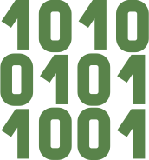
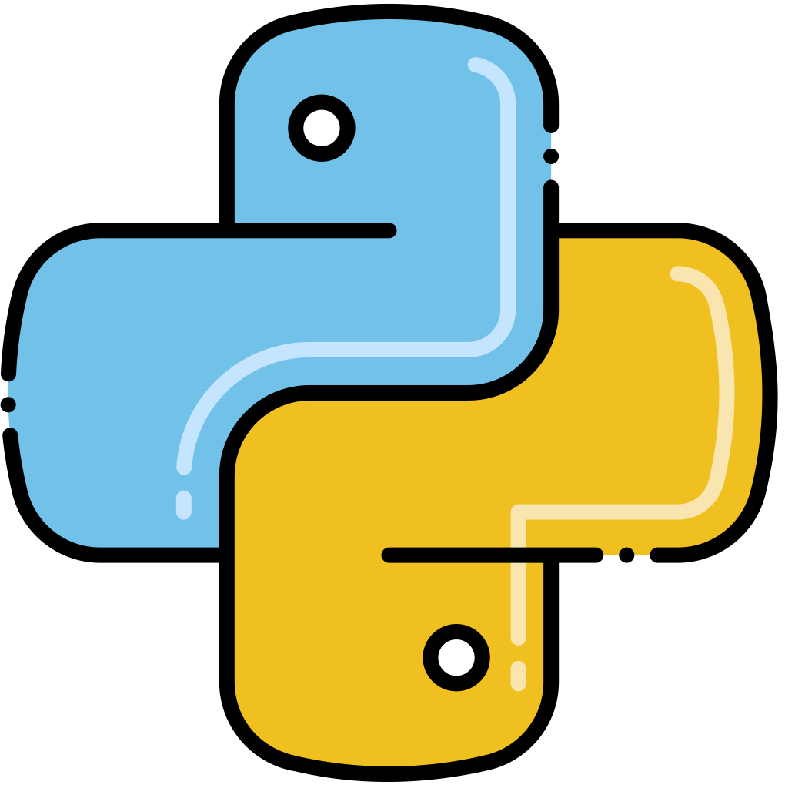
So do I need to talk in 0's 1's Language
No
Luckily, we have programming languages.
Python is a very powerful but easy-to-understand language.
We write in Python
Computer convert to 0s and 1s

Slide 11
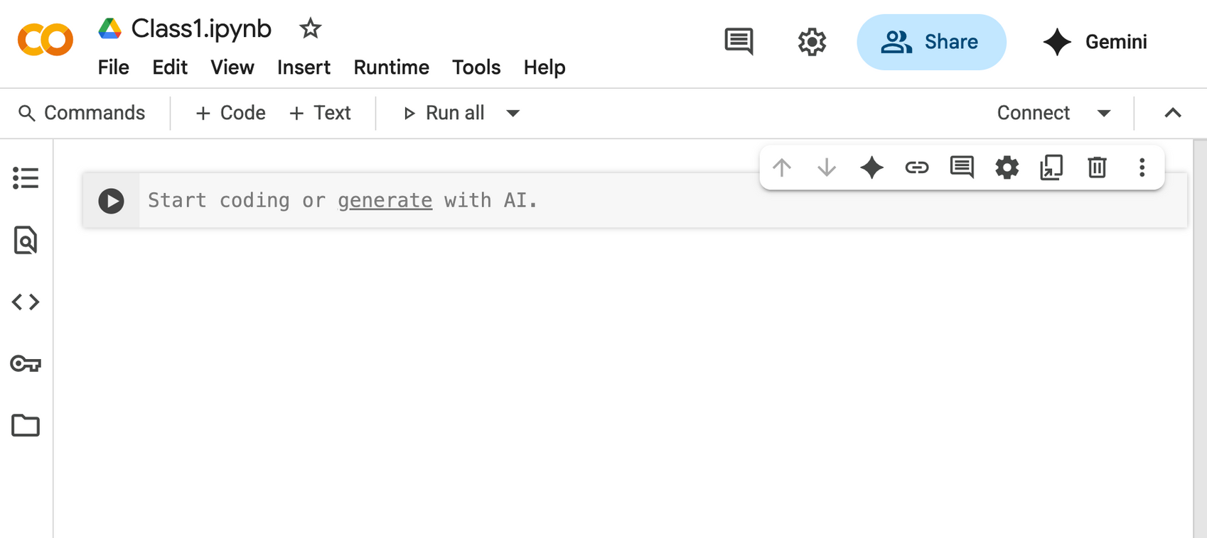
Setup CoLab
https://colab.google

Slide 12
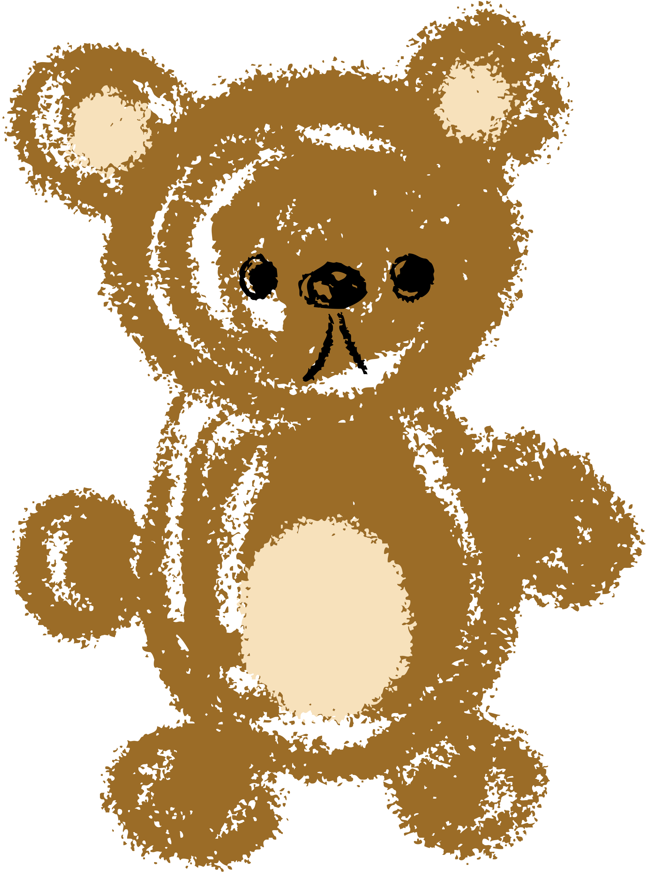
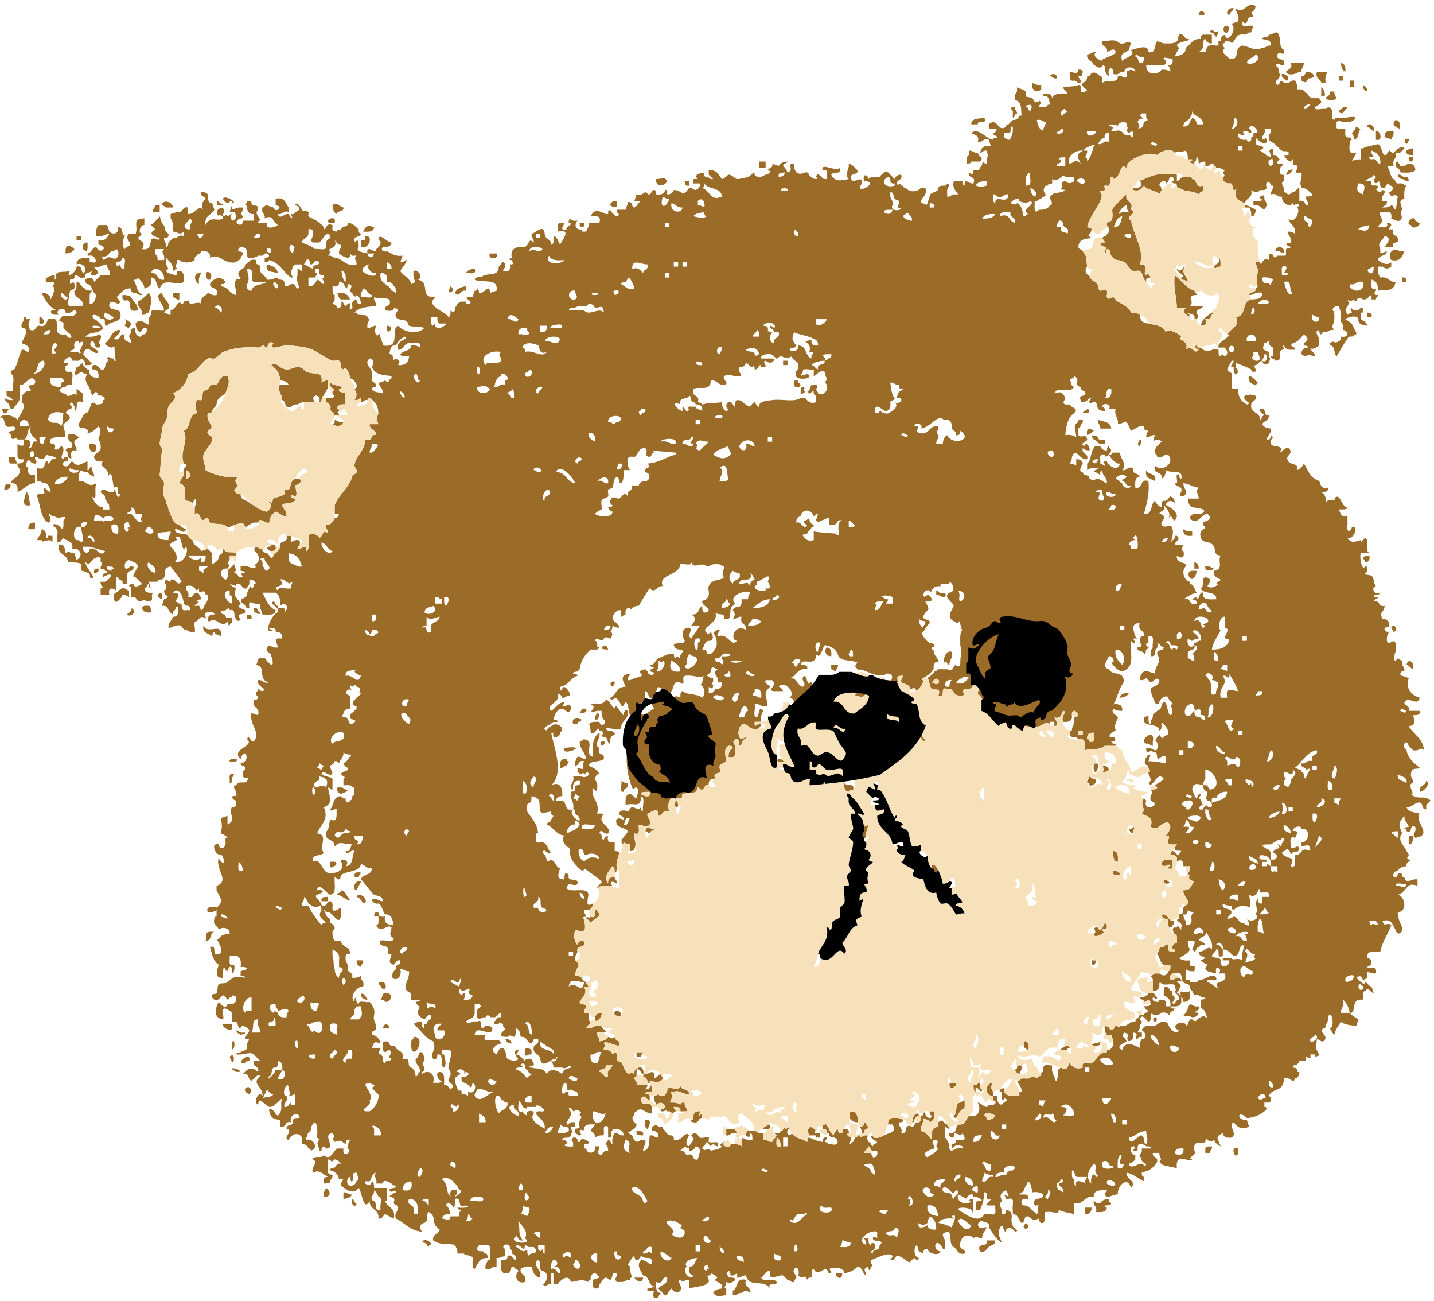
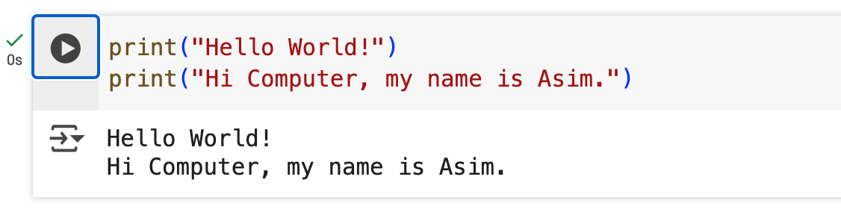
Task # 1: Hello World !

Slide 13
Task # 2: String vs. Number
print("4 + 9 = ", 4 + 9)
String: Anything inside “” will print as it is.
Expression is computed e.g. 4+9
, is used to join them

Slide 14
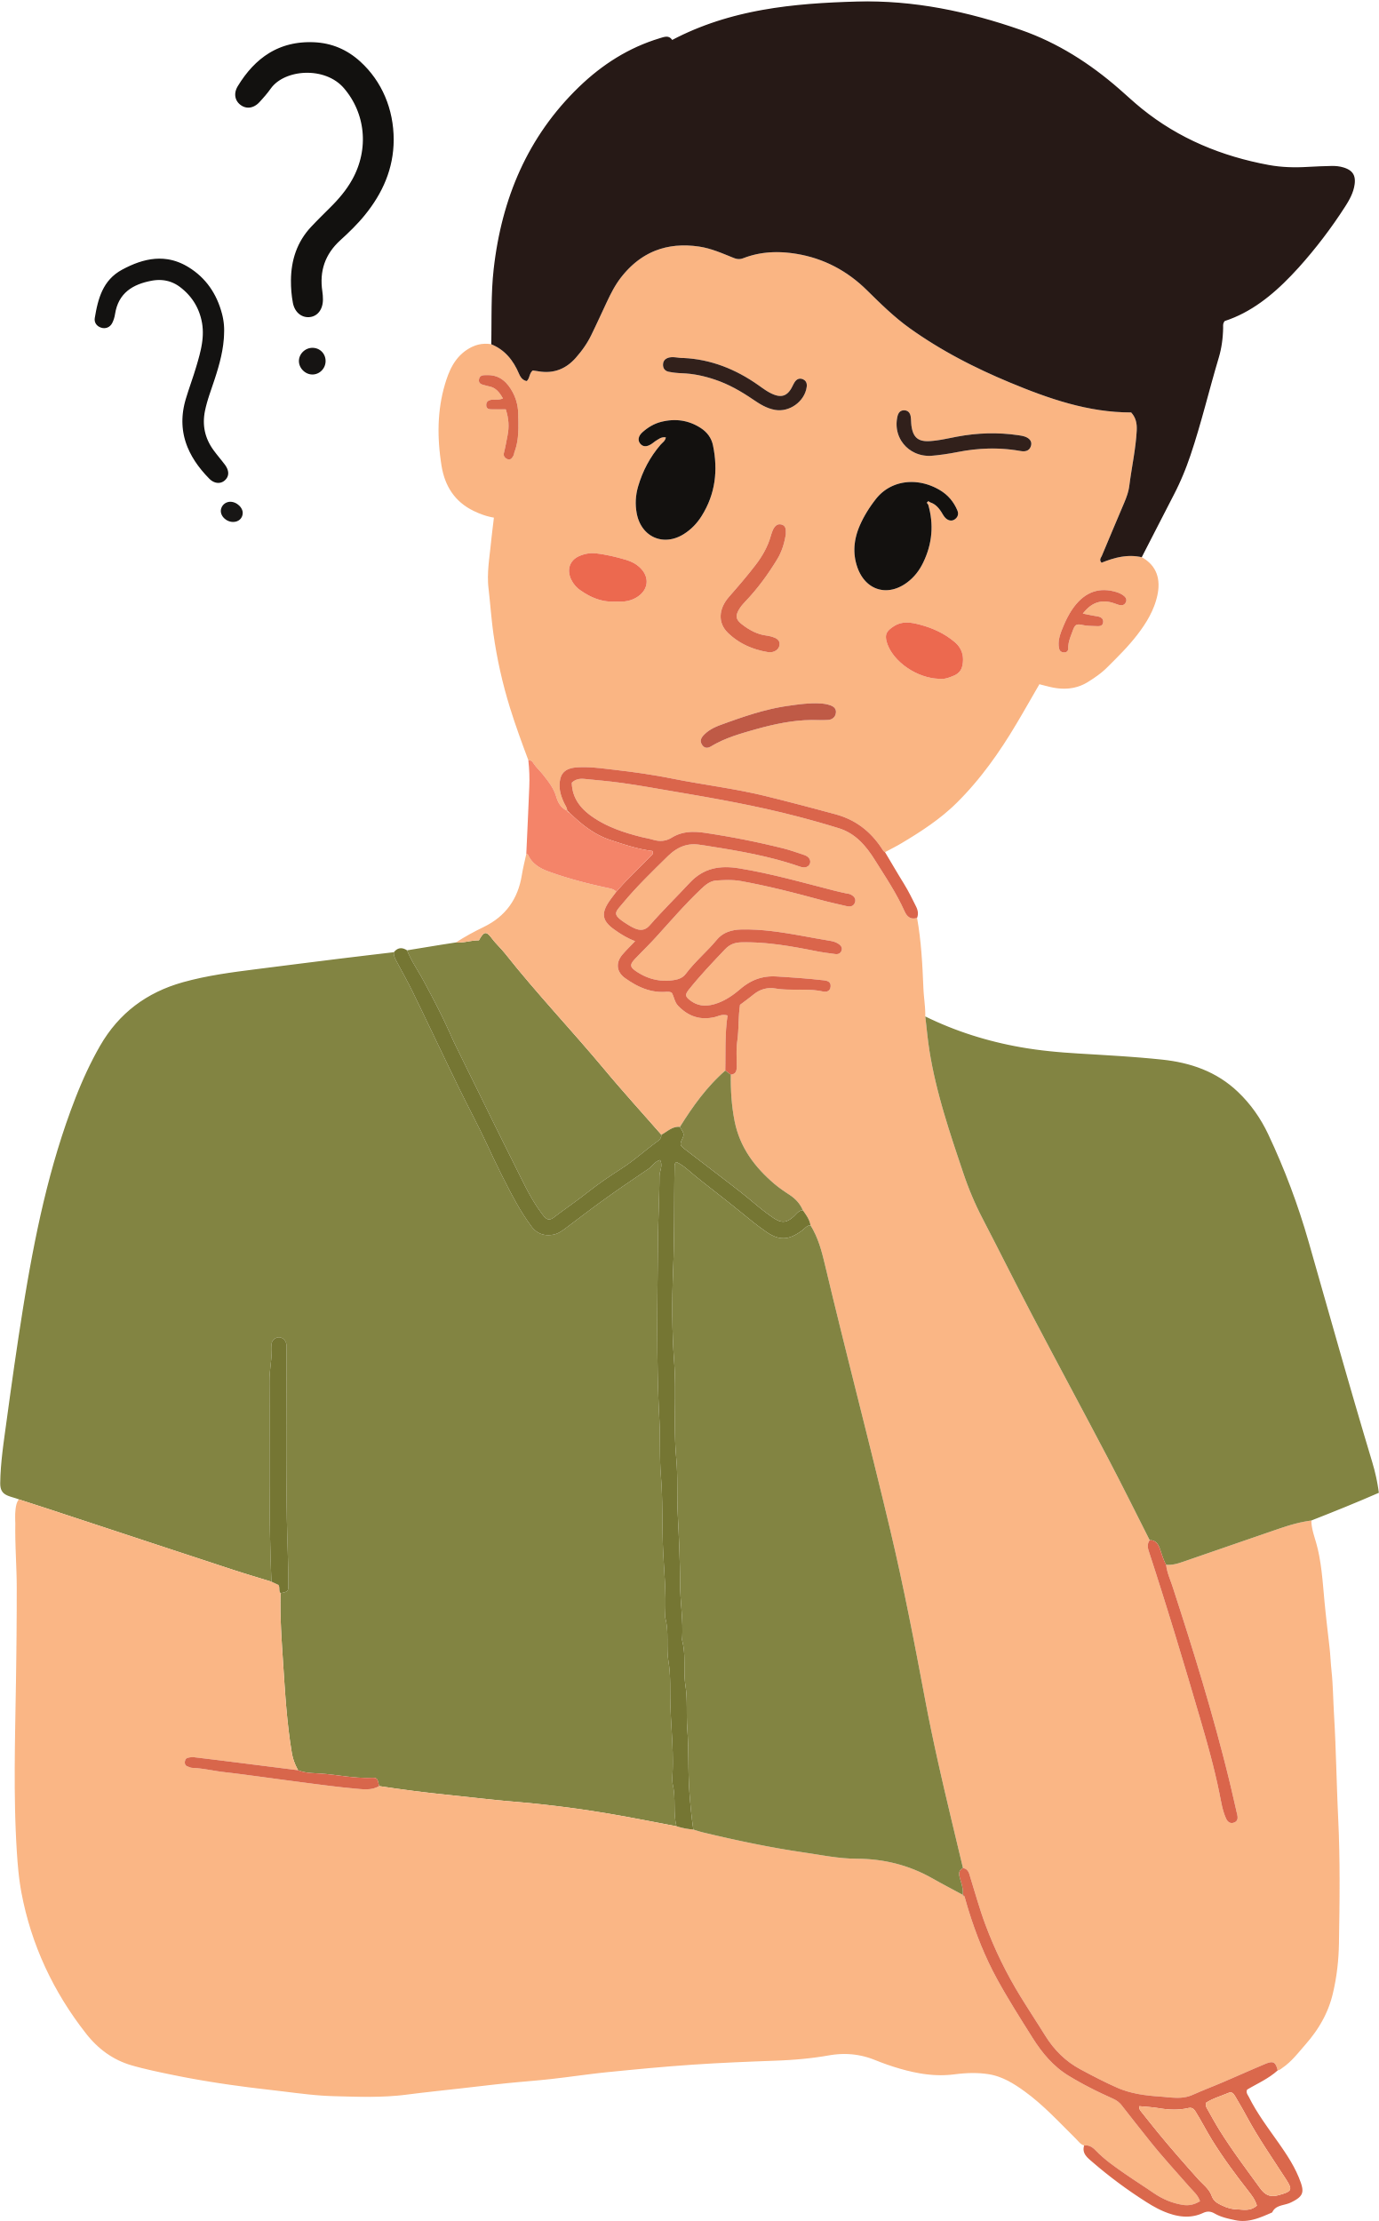

Task # 3: Variables
How can we multiply string
a = "Asim"
print("*" * 20)
print("*** Welcome,", a, "***")
print("*" * 20)

Slide 15
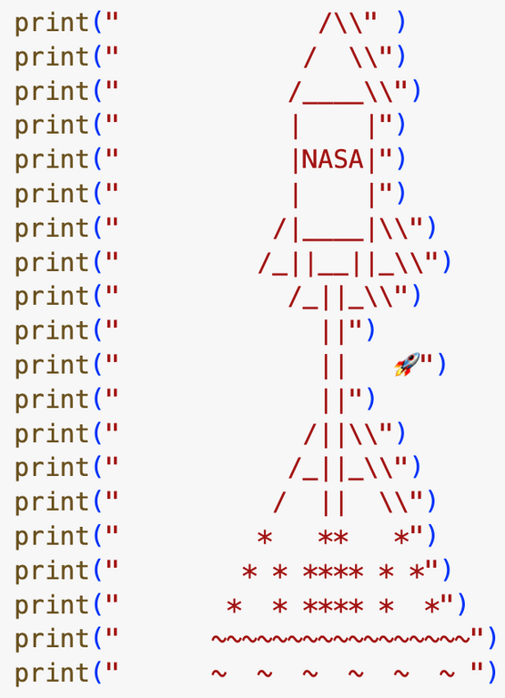
Task # 3: Draw Pattern
https://emojipedia.org

Slide 16
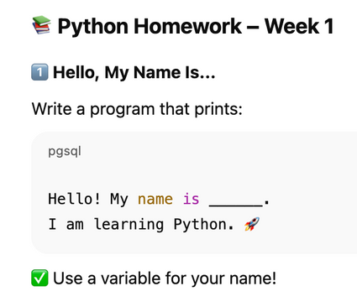
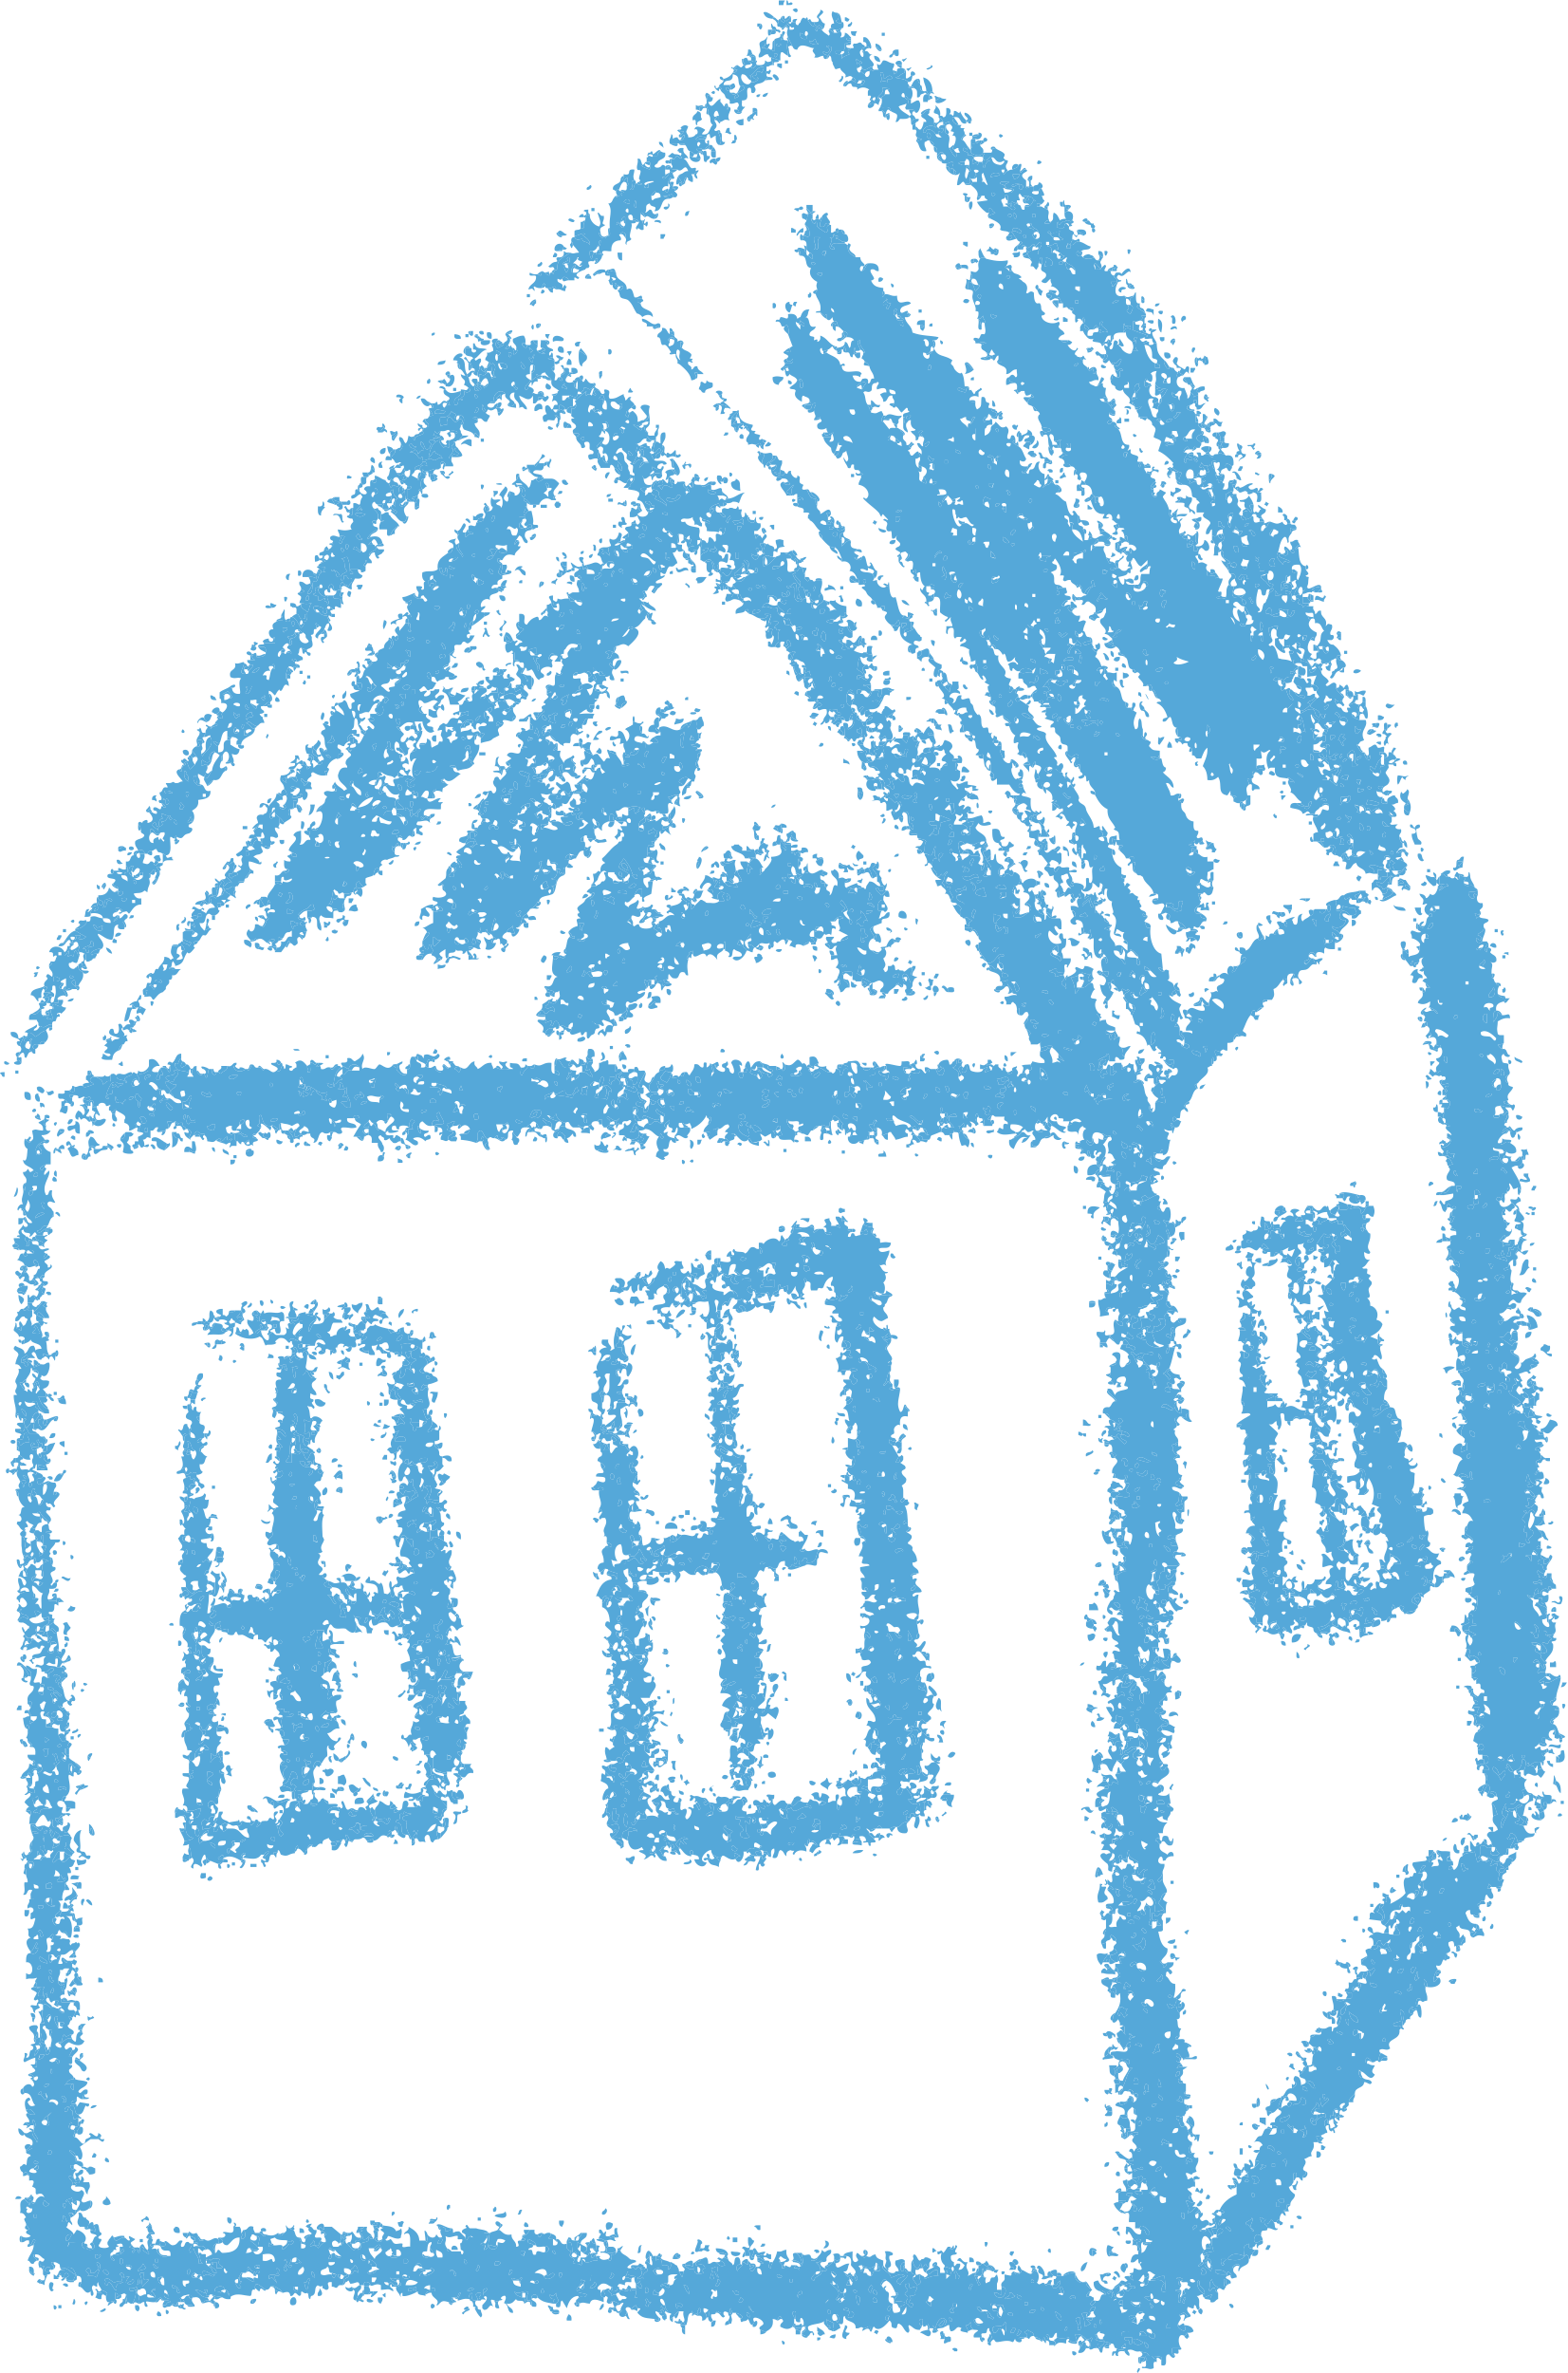
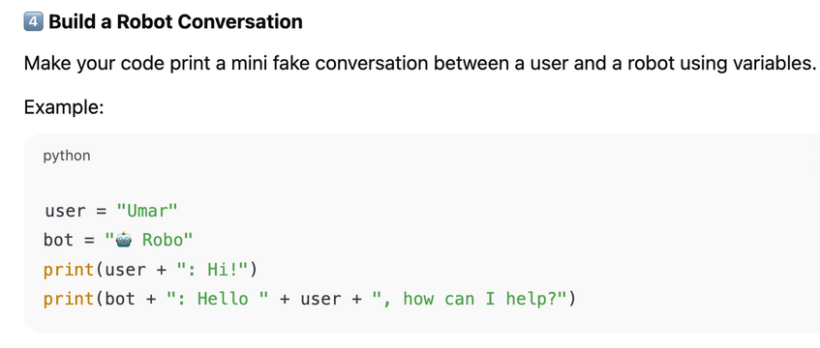
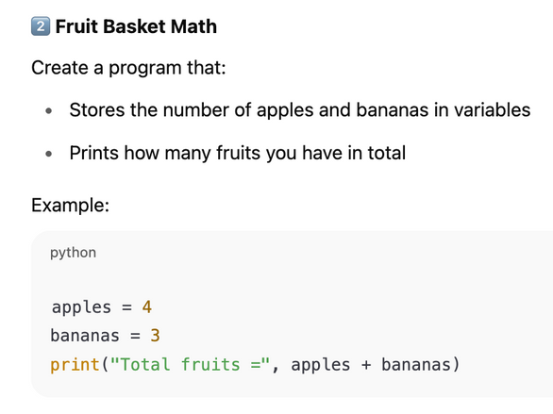
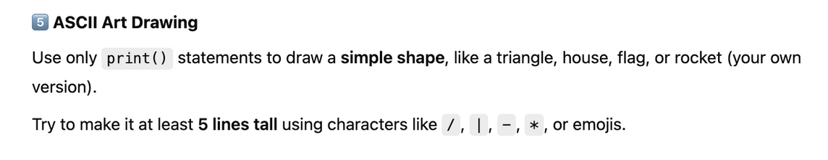
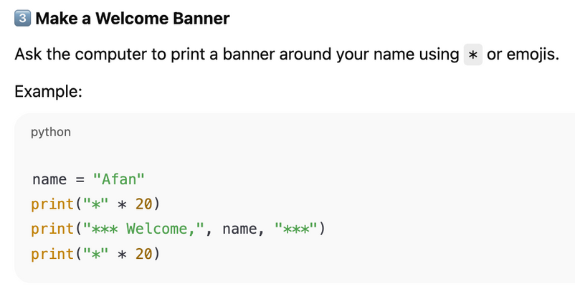
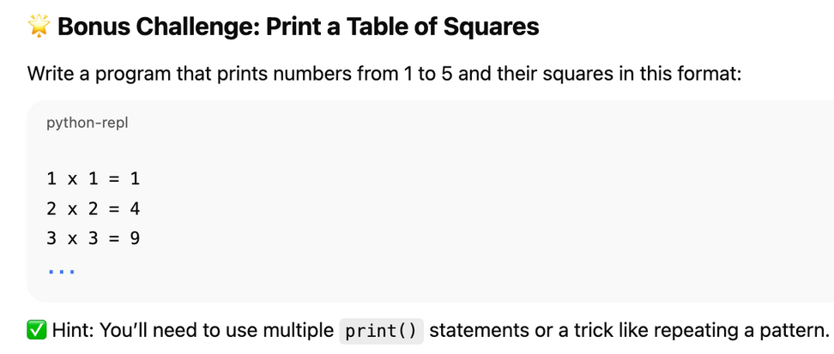
Homework
https://emojipedia.org

Slide 17


Thank You

